Slide 1
NETL Mission & Activities
NETL Webinar on Fossil Energy’s Minority Serving Institutions Program
November 9, 2016
Robert Romanosky, Ph.D.
Crosscutting Technology Manager
National Energy Technology Laboratory
Notes:
SLIDE 2
THE NEED FOR ABUNDANT ENERGY ON A GLOBAL SCALE WILL REQUIRE AN “ALL OF THE ABOVE” ENERGY STRATEGY….AND MORE IMPORATNLY TECHNOLOGIES ENABLING AFFORDABILITY AND CLEAN UTILIZATION
These images represent the energy pillars detailed in the presidential plan
The bullets detail the administration’s priorities
This strategy allows us not to pick winners and losers, but really manage risks associated with an unknown energy future

Slide 2
“All of the Above” Energy Future
Fuel Efficiency
Solar
Clean Coal
Biofuels
Carbon Capture & Storage
Safe & Responsible Domestic Oil & Gas Production
Advancing Clean Energy
Advancing Energy Efficiency
Developing Clean Fuels
Nuclear
Wind
Oil
Natural Gas

Slide 3
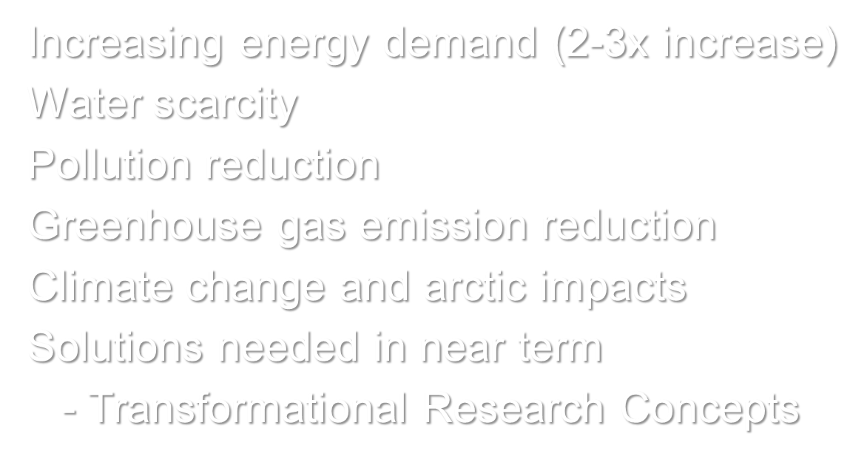
Many Energy & Environmental Challenges

Slide 4
ENERGY DEMAND PROJECTION
Energy Demand 2011
Energy Demand 2035
104 QBtu / Year 81% Fossil Energy
97 QBtu / Year 83% Fossil Energy
Coal
20%
Gas
26%
+ 7%
Coal
18%
Gas
30%
Oil
36%
Nuclear
9%
United States
Oil
33%
Nuclear
8%
Renewables
9%
5,498 mmt CO₂
Renewables
11%
5,546 mmt CO₂
519 QBtu / Year
82% Fossil Energy
740 QBtu / Year
80% Fossil Energy
Gas
21%
+ 43%
Coal
29%
Gas
23%
Coal
29%
Nuclear
5%
World
Nuclear
6%
Oil
32%
Oil
27%
Renewables
13%
31,162 mmt CO₂
Renewables
15%
43,111 mmt CO₂
U.S. data from EIA, Annual Energy Outlook 2014 early release; World data from IEA, World Energy Outlook 2013

Slide 5
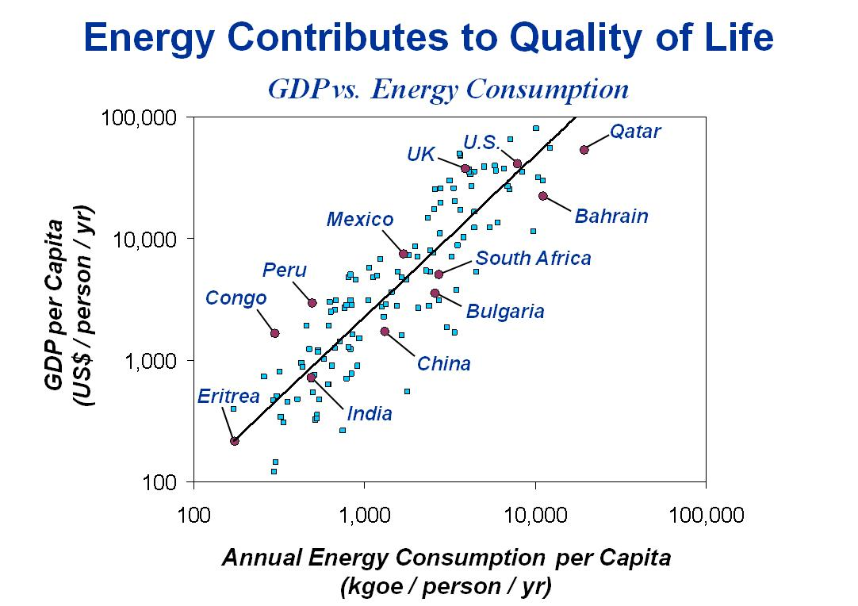
Point of Reference
Competing demands for reliable, low-cost energy and climate change mitigation
Uncertainty of regulatory outcomes and rising costs impact opportunities for capital investment, production capacity, and other factors in an integrated infrastructure
Carry out research and development to foster new processes that address conflicting energy objectives
Our laboratory’s mission is to increase efficiency and mitigate CO₂ emissions in current plants and to develop novel carbon capture ready power generation processes

Slide 6
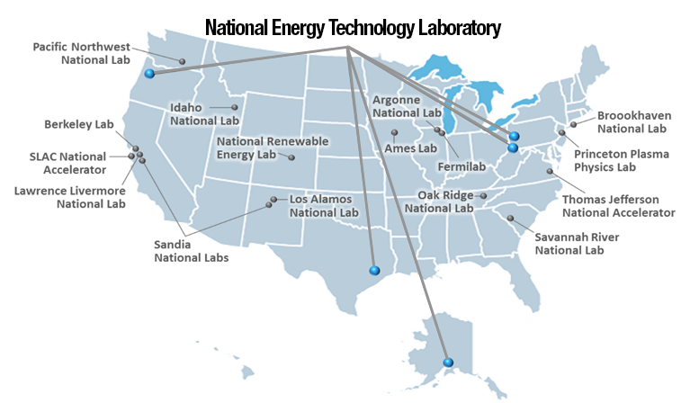
NETL: THE Fossil Energy Laboratory
NETL’s mission is to discover, integrate, and mature technology solutions to enhance the Nation’s energy foundation and protect the environment for future generations
Office of Science
National Nuclear Security Administration
Environmental Management
Fossil Energy
Nuclear Energy
Energy Efficiency & Renewable Energy
Notes:
SLIDE 3
NETL IS THE ONLY DOE LAB DEDICATED TO THE FOSSIL ENERGY MISSION
1 of 17 DOE labs: Maintain enduring competencies critical to the FE mission
1 of 3 applied labs: Provide technology solutions
The only GOGO laboratory → provides unique practices to conduct, collaborate and implement R&D

Slide 7
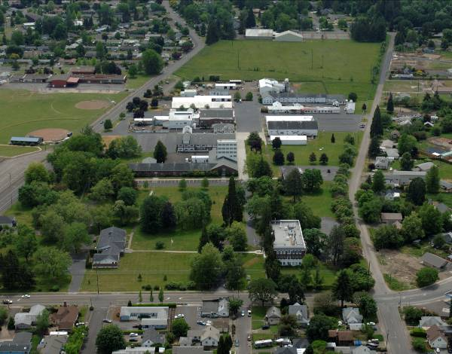
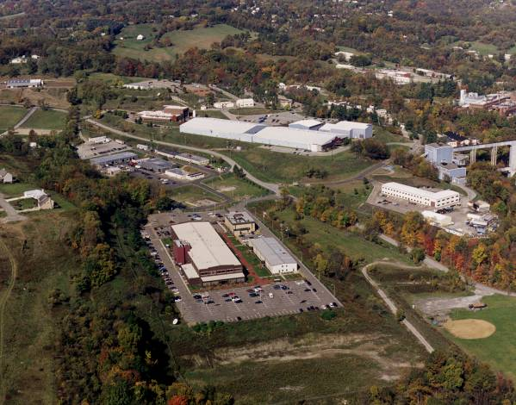
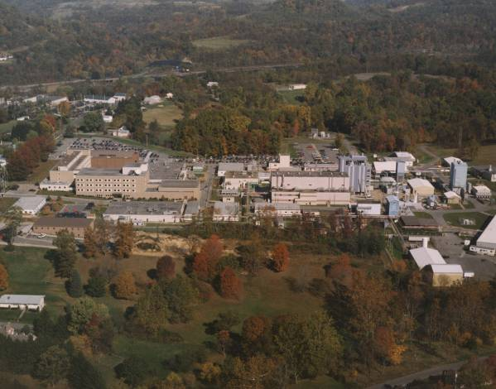
National Energy Technology Laboratory Where Energy Challenges Converge and Energy Solutions Emerge
Only government owned & operated DOE national lab
Dedicated to energy RD&D, domestic energy resources
Fundamental science through technology demonstration
Unique industry–academia–government collaborations
Oregon
Pennsylvania
West Virginia

Slide 8
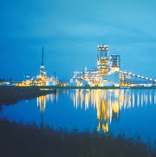
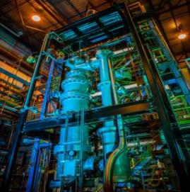
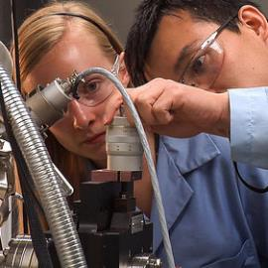
Technology Readiness… Maturing Technology
Technology Demonstration
TRL 8-9
Extramural
Energy Solutions
for Today
Energy Options for Tomorrow
Process Engineering
& Integration
TRL 5–7
Intramural &
Extramural
Applied Research
TRL 2-4
TRL=Technology Readiness Level
Notes:
SLIDE 4
(OUR APPROACH IN THE DOE NL SYSTEM RATHER UNIQUE, PARTIALLY DUE TO OUR GOGO MODEL) OUR GOAL IS TO ACCELERATE THE DEVELOPMENT OF TECHNOLOGY SOLUTIONS/OPTIONS THROUGH STRATEGIC PARTERNSHIPS
Technology Demonstration: Allow the “technology users” to demonstrate fully integrated systems at near commercial scale
Process Engineering & Integration: Leveraging expertise in the commercial sector to engineer, build and integrate at pilot scale
Technology Pull Applied Research: Leveraging the best and brightest innovators in academia and the NL system

Slide 9
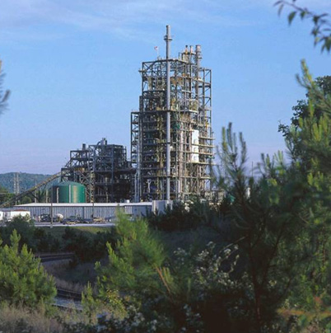
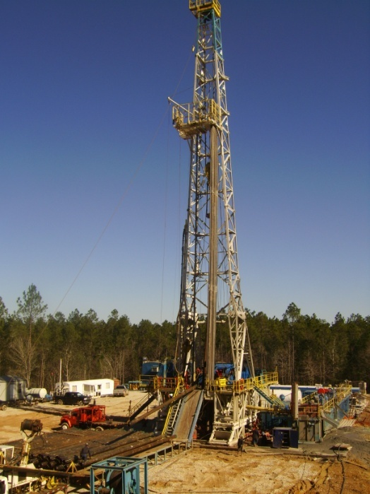
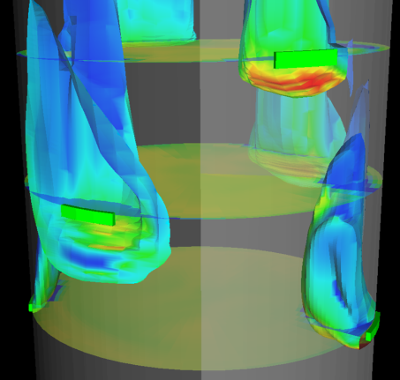
Fiscal Year 2016 NETL Office of Coal and Power R&D Core Programs
Carbon Capture
Carbon Storage
Advanced Energy Systems
Advanced Combustion
Gasification Systems
Hydrogen Turbines
Fuel Cells
Fuels
Crosscutting Research
Systems Analysis and Planning
Working in synergy, these programs are developing technologies to increase power plant efficiency, lower electricity costs and mitigate GHG emissions in both existing and advanced power facilities

Slide 10
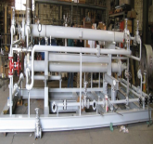
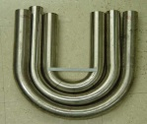
Coal Technology Thrusts
Advanced Energy Systems
Technologies that greatly improve plant efficiencies, reduce CO2 capture costs, increase plant availability, and maintain the highest environmental standards
Carbon Capture
R&D and scale-up technologies for capturing CO2 from new and existing industrial and power-producing plants
COAL
Carbon Storage
Safe, cost- effective, and permanent geologic storage of CO2
Cross Cutting Research
Materials, sensors, and advanced computer systems for future power plants and energy systems integrated with CCS
Notes:
SLIDE 7
CARBON CAPUTRE CAN BE ACCOMPLISHED TODAY, BUT WE ARE FOCUSED ON SEVERAL CHALLENGES THAT WILL MAKE IT FEASIBILE FOR THE CONSUMER
Cost Effectiveness – Current carbon capture technologies are expensive and energy-intensive, resulting in a cost of electricity (COE) increase of approximately 100 percent and a cost to capture CO₂ nearly double what it can be sold for in today’s EOR market. Reducing both these costs to practical levels is a significant challenge.
System Integration – In most cases, integrating the CO₂ capture subsystem with the balance of plant will increase operational and thermodynamic efficiency; however, the cost and complexity associated with this integration represent a significant barrier to overcome.
Scale Up – While industrial-scale CO₂ separation processes are now commercially available, they have not been deployed at the scale required for large power plant applications. As these technologies advance, integration with the balance of full-scale plant is likely to become more complex. Addressing deployment and integration issues at relevant scales is essential in minimizing low carbon power production costs.
Supply Chain – Current gas processing and separation industry would need to be scaled at least an order of magnitude from today’s capacity. The increased scale will put strains on commodities needed for solvent, sorbents, and membranes, as well as the more conventional equipment vendors that will need steel and other commodities.
Thermodynamics – In most cases, the CO₂ is present along with significant amounts of other gaseous constituents, which reduces the driving force for separation from flue gas and increases the thermodynamic cost of separation.
Parasitic Load – A significant amount of auxiliary power is required to operate currently available CO₂ capture technologies. The auxiliary power decreases the net electrical generation of the power plant.
CO₂ Compression – For most carbon dioxide disposition options, significant power is required to compress the captured CO₂ to pressures at which it can be stored or utilized. Reducing this power requirement helps improve overall plant efficiency and facilitates CO₂ storage for both existing and future power plants.
Flue Gas Contamination – Constituents in the flue gas, particularly sulfur, can contaminate CO₂ capture technologies, lead­ing to increased operational expenses.
Water Use – Depending on the technology, a significant amount of water use may be required for CO₂ capture and compression cooling.

Slide 11
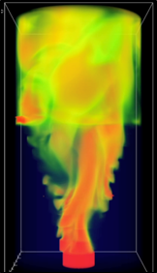
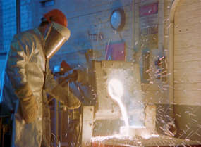
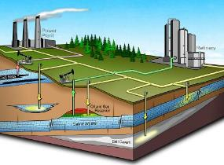
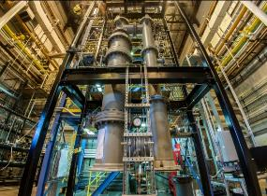
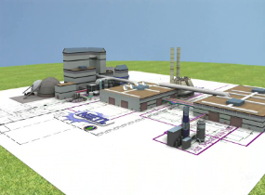
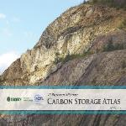
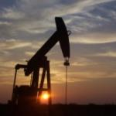
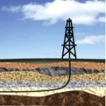
Technology Thrusts
Computational Engineering
Materials Engineering & Manufacturing
Geological & Environmental Systems
Energy
Conversion
Engineering
Systems
Analysis & Engineering
COAL
Carbon
Storage
Carbon
Capture
Sensors
Advanced
Materials
Advanced
Computing
Advanced Energy
Systems
OIL & GAS
Enhanced
Resource Production
Environmentally
Prudent Development
Transmission
& Delivery
Methane
Hydrates
Notes:
SLIDE 6
THE LABROATORY MATIXES OUR ENDURING, WORLD CLASS CORE COMPETENCIES (IMAGES ACROSS THE TOP) INTO OUR TECHNOLOGY THRUSTS OF OUR FE MISSION (ROWS)
Providing relevant energy solutions today
Highlights by our current technology Thrusts
Providing technology options for tomorrow
Maintaining critical core competencies ready to be leveraged in urgent circumstances (i.e. Gulf oil spill)

Slide 12
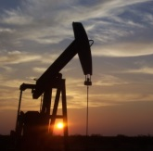
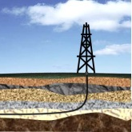
Oil and Gas Technology Thrusts
Enhanced Resource Production
Maximize recovery and reduce environmental impacts of conventional, unconventional and offshore resources
Environmentally Prudent Development
Water quality and availability, air quality, induced seismicity, and development intensity
Oil & Gas
Transmission & Delivery
Quantifying, detecting and reducing methane emissions from the natural gas value chain
Methane Hydrates
Developing technology to enhance recovery, and unlocking the potential of the next energy frontier
Notes:
SLIDE 8
CARBON CAPUTRE CAN BE ACCOMPLISHED TODAY, BUT WE ARE FOCUSED ON SEVERAL CHALLENGES THAT WILL MAKE IT FEASIBILE FOR THE CONSUMER
Cost Effectiveness – Current carbon capture technologies are expensive and energy-intensive, resulting in a cost of electricity (COE) increase of approximately 100 percent and a cost to capture CO₂ nearly double what it can be sold for in today’s EOR market. Reducing both these costs to practical levels is a significant challenge.
System Integration – In most cases, integrating the CO₂ capture subsystem with the balance of plant will increase operational and thermodynamic efficiency; however, the cost and complexity associated with this integration represent a significant barrier to overcome.
Scale Up – While industrial-scale CO₂ separation processes are now commercially available, they have not been deployed at the scale required for large power plant applications. As these technologies advance, integration with the balance of full-scale plant is likely to become more complex. Addressing deployment and integration issues at relevant scales is essential in minimizing low carbon power production costs.
Supply Chain – Current gas processing and separation industry would need to be scaled at least an order of magnitude from today’s capacity. The increased scale will put strains on commodities needed for solvent, sorbents, and membranes, as well as the more conventional equipment vendors that will need steel and other commodities.
Thermodynamics – In most cases, the CO₂ is present along with significant amounts of other gaseous constituents, which reduces the driving force for separation from flue gas and increases the thermodynamic cost of separation.
Parasitic Load – A significant amount of auxiliary power is required to operate currently available CO₂ capture technologies. The auxiliary power decreases the net electrical generation of the power plant.
CO₂ Compression – For most carbon dioxide disposition options, significant power is required to compress the captured CO₂ to pressures at which it can be stored or utilized. Reducing this power requirement helps improve overall plant efficiency and facilitates CO₂ storage for both existing and future power plants.
Flue Gas Contamination – Constituents in the flue gas, particularly sulfur, can contaminate CO₂ capture technologies, lead­ing to increased operational expenses.
Water Use – Depending on the technology, a significant amount of water use may be required for CO₂ capture and compression cooling.

Slide 13
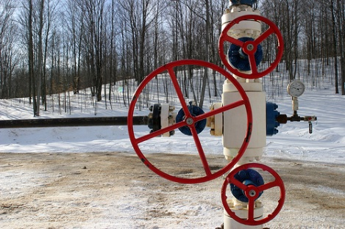
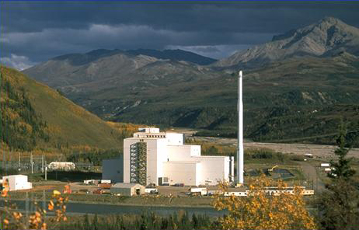
Return on Investment from Fossil Energy R&D
FE RESEARCH — THE RETURN ON INVESTMENT
16 million tons of avoided
NO_{x} emissions 2000–2020¹
37 million tons of avoided
SO₂ emissions 2000–2020¹
1.2 million jobs created
2000–2020¹
Thousands of scientists and engineers trained
$111 billion
in benefits
2000–2020¹
$13 return for every $1 invested¹
650 U.S. fossil energy patents 1976–2013⁴
58 GW of mercury-control technology installed ²
148 GW projected by 2015³
$1.9 trillion
in health benefits⁵
FE research contributes to EPA-estimated health benefits from reduced pollution
1990–2020
¹Bezdek, R., Wendling, R., The Return on Investment of the Clean Coal Technology Program in the USA. Energy Policy, Vol. 54, March 2013, pp. 104–112. ²Institute of Clean Air Companies, http://www.icac.com/?page=Mercury_Controls, Updated Commercial Hg Control Technology Bookings (October 2011), accessed 08/21/13. ³EPA Base Case, IPM analysis of EGU GHG NSPS, downloaded from http://www.epa.gov/airmarkets/progsregs/epa-ipm/proposedEGU_GHG_NSPS.html, 08/21/13. ⁴USPTO online search 08/29/13 on ABST/("fossil fuel*" OR coal OR oil OR petroleum OR "natural gas" OR methane OR hydrate) AND (electric* OR energy OR power OR generat* OR turbine) AND (AN/"department of energy" OR GOVT/"department of energy"). ⁵The Benefits and Costs of the Clean Air Act from 1990 to 2020, U.S. EPA Office of Air and Radiation, March 2011.

Slide 14
Conclusions
The U.S. power generation industry is at a critical juncture
Demand, resources, workforce, reliability, regulation, grid integrity, transmission, etc.
Competing demands for reliable, low-cost energy and climate change mitigation appear incongruent
Uncertainty of regulatory outcomes and rising costs impact industry’s willingness to commit capital investment, endangering near-term production capacity
The U.S. must foster new processes that address conflicting energy objectives simultaneously

Slide 15
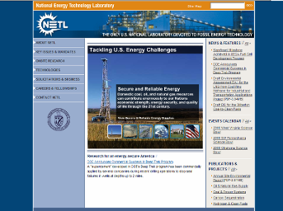
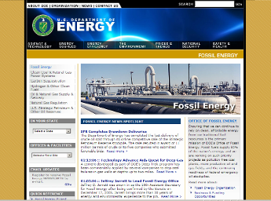
Contact Information
Robert R. Romanosky, Ph.D.
Crosscutting Research Technology Manager
304-285-4721
Robert.romanosky@netl.doe.gov
NETL www.netl.doe.gov
Office of Fossil Energy www.fe.doe.gov

Slide 16
Solutions for Today Options for Tomorrow
For More Information, Contact NETL
www.netl.doe.gov
Notes:
I WOULD ENCOURAGE YOU TO REACH OUT TO US FOR FURTHER DISCUSSION AND HOPEFULLY COLLABORATION

